Slide 1

Biometric Authentication using Mouse Dynamics
Arnab Biswas(Roll-21EC65R01)
Yashwanth Solasa(Roll-21EC65R08)
Alisha Oraon(Roll-21EC65R04)
Kavitha Annepu(Roll-21EC65R20)
Ritwik Das(Roll-21EC65R02)

Slide 2
Biometric Authentication
Method use for verification or identification of a person.
Can be two types-Physiological biometrics and Behavioural biometrics.
Physiological biometrics can be done by using face, fingerprint, iris etc.
Behavioural biometrics can be done by using mouse dynamics and key log dynamics.

Slide 3
Problem Statement
The objective of the project is to create a continuous user authentication system for PCs/laptops to prevent threats against intruders, using biometrics involving mouse dynamics. The program was implemented to authenticate the user by K- Nearest Neighbor Classifier.

Slide 4
System Architecture
DATA ACQUISITION
FEATURE EXTRACTION AND SELECTION
MODEL TRAINING AND TESTING
PERFORMANCE ANANLYSIS

Slide 5
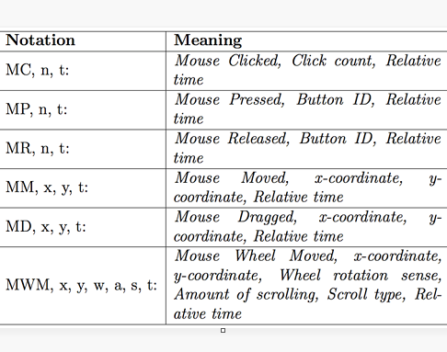
Mouse Dynamics
contains following information-
Mouse Move
Mouse Press
Mouse Release
Mouse drag
X,Y coordinates of the screen

Slide 6
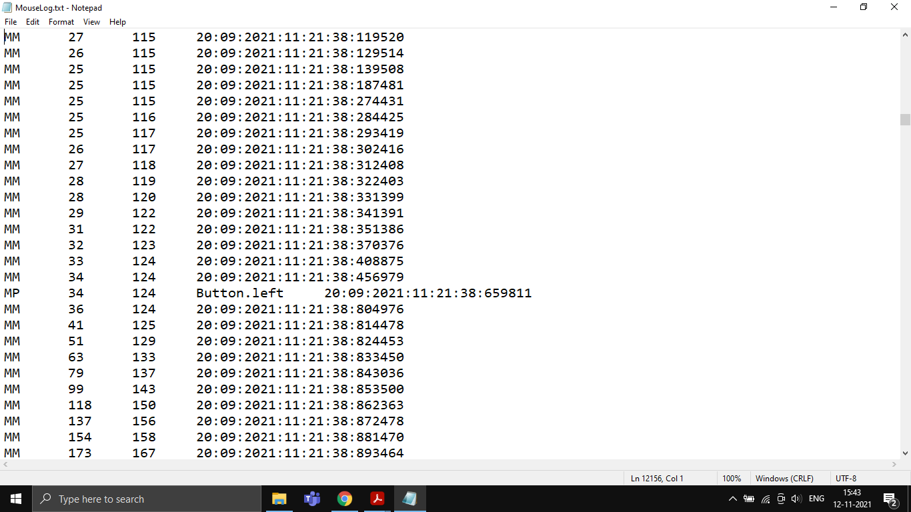

Slide 7
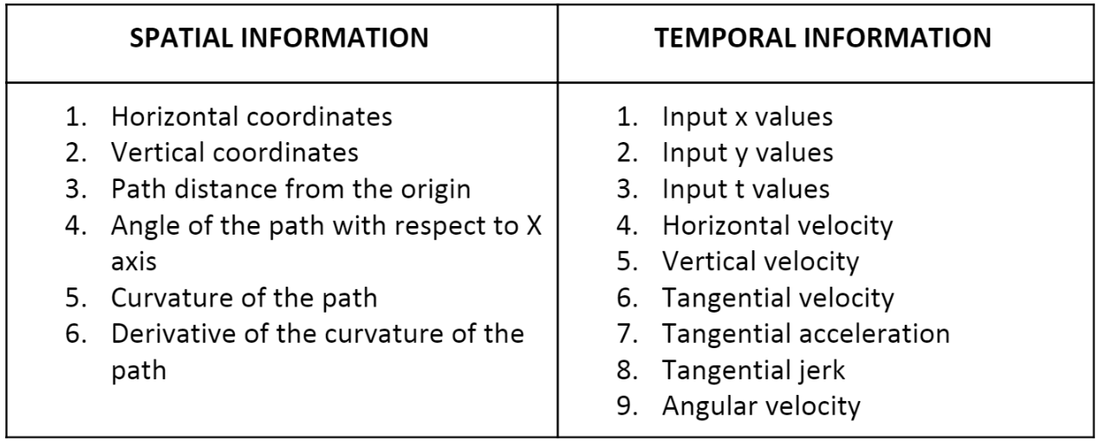

Slide 8
k-NN Algorithm
It considers K Nearest Neighbors (Data points) to predict the class or continuous value.
Prediction of class comes under Classification and predicting new data point based on the training data sets comes under Regression.
Here we do not learn weights from training data to predict output but uses entire training instances to predict output for unseen data.
k is the crucial parameter in this algorithm, that can be chosen by domain knowledge or by error curves.

Slide 9
Advantages and disadvantages
Simple to implement.
More effective when the training data is large.
Training is fast.
Robust to noisy data.
Choosing k value may complex sometimes.
Computation cost is high.
Requires more memory to store all training data.

Slide 10
Methodology
In this project, the data of mouse dynamics was acquired to authenticate the user by training and testing using KNN classifier from the data acquired by continuous authentication data of our group (group 12). The data was collected by all the 5 members of our group for weeks . We got the data of 5 members of our group and assigned each member as one class. We used KNN-algorithm for training the model and then we calculated the accuracy.

Slide 11
Algorithm
Dataset collection :
Reference:- Folder named '\data'.
Collected using the mouse.jar application.
Continuous data was collected over a period of time by various users.
Extracting Dataset :
Reference :- extractor.py is used for extracting data
Pre-processes the raw data and transforms it to contain pause time and statistical features for all combinations of mouse dynamics.
The basics of mouse movement: X-coordinate, Y-coordinate, Theta value etc are extracted.

Slide 12
3) KNN Classifier :
Data obtained from extractor.py is used as input.
Data for each user is assigned a particular class value (0,1,2,..).
Train-test split is done separately for each class to ensure the train and test set contain appropriate proportions of each class.
Whole data is then merged, while maintaining the train-test split.
Select the number K of the neighbors
Calculate the Euclidean distance of K number of neighbors
Take the K nearest neighbors as per the calculated Euclidean distance.
Among these k neighbors, count the number of the data points in each category.
Assign the new data points to that category for which the number of the neighbor is maximum.
Accuracy is calculated from the predicted data and test data class label.

Slide 13
CROSS VALIDATION:
Cross-validation is when the dataset is randomly split up into 'k' groups. One of the groups is used as the test set and the rest are used as the training set. The model is trained on the training set and scored on the test set. Then the process is repeated until each unique group as been used as the test set.

Slide 14
Why cross validation?
Cross Validation is a very useful technique for assessing the effectiveness of your model, particularly in cases where you need to mitigate overfitting.

Slide 15
Observation
Accuracy obtained from k-NN algorithm is 100%.
Accuracy obtained from cross-validation is 100%.
k value in k-fold cross-validation for the above example is 4 (i.e k=4), had we split the training data into 5 equal parts, the value of k=5.

Slide 16
Thank You

